Slide 1
Machine Learning Introduction

Slide 2
Agenda
What is Machine Learning
Know about BigData
Pre-requisites for Machine Learning
Types of Machine Learning
Machine Learning Workflow
Top Machine Learning tools
Examples

Slide 3



What is Machine Learning
Learn from Experience
Learn from Data
Follow the Instruction

Slide 4
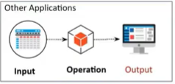
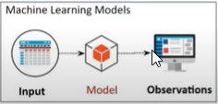
What is Machine Learning
Machine learning is the study of computer algorithms that improve automatically through experience and by the use of data.
Machine learning is a type of artificial intelligence that enables self-learning from data and then applies that learning without the need for human intervention.

Slide 5
AI <--- ML <--- DL <--- DS
AI – Enables the Machine to think
Data Science
ML– Provides the statistical tools to explore the data
DL – Multi Neural Network Architecture(ANN, CNN, RNN)

Slide 6
Fuel of Machine Learning - Data
What is BigData?
Characteristics of BigData.
Types of Data.
How BigData is driving the Business Optimization.
Data is a boon for machine learning systems.

Slide 7
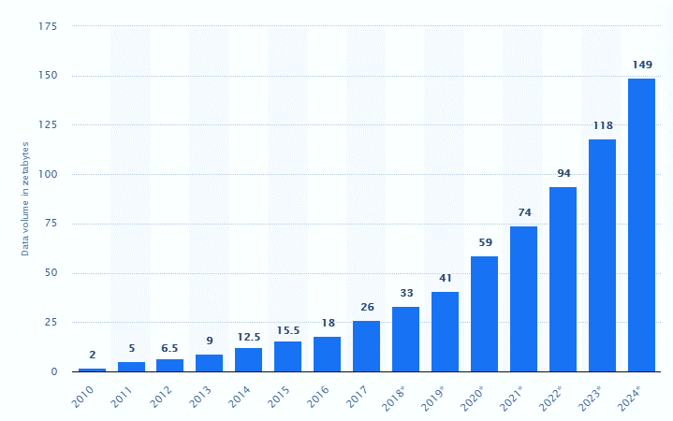
Fuel of Machine Learning - Data

Slide 8
Requisites for Machine Learning
Programming Language
Python & R
Mathematics and Statistics
Linear Algebra, Probability and Random process etc
Database and SQL
RDBMS(MySQL, MSSQL, Postgres etc), NoSQL
Data Wrangling
Data Preparation
Data Visualization
Python Libraries, Tableau, PowerBI
Machine Learning

Slide 9
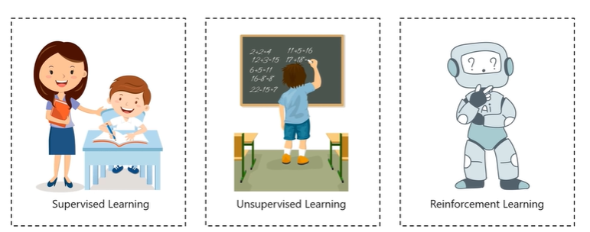
Types of Machine Learning

Slide 10
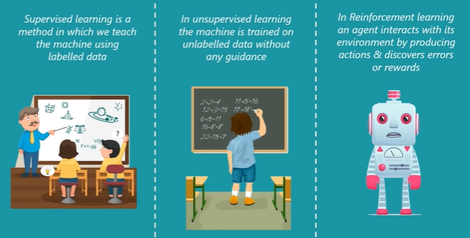

Slide 11
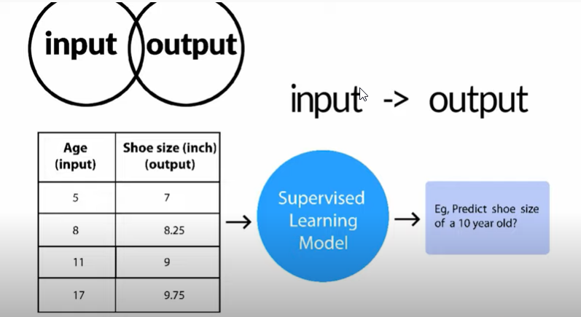
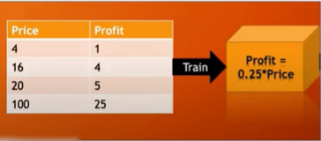
Supervised Learning

Slide 12
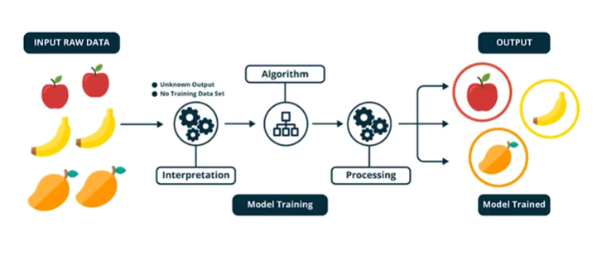
Unsupervised Learning

Slide 13
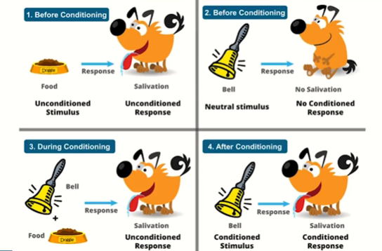
Reinforcement Learning

Slide 14
Machine Learning Workflow
Data Collection
Exploratory Data Analysis
Data Processing
Training and testing the model on data
Analysis/Evaluation
Deployment

Slide 15
Challenges/Issues in Machine Learning
1. Scarcity of Data
2. Unclear question
3. Unclear Representation of data
4. Inadequate Infrastructure
5. Machine learning Algorithm selection
6. Lack of Skilled Resources

Slide 16
Top Machine Learning Tools
Microsoft Azure Machine Learning
IBM Watson
Google TensorFlow
Amazon Machine Learning
OpenNN

Slide 17
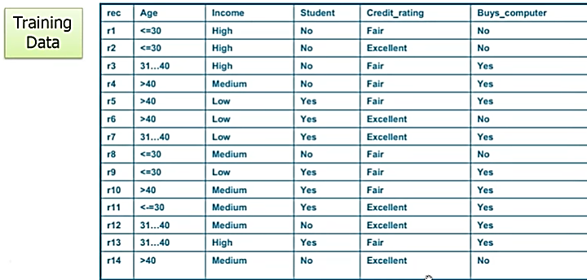
Example 1 – Decision Tree

Slide 18
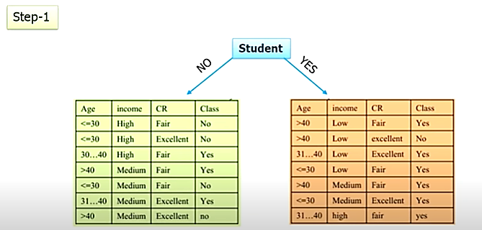

Slide 19
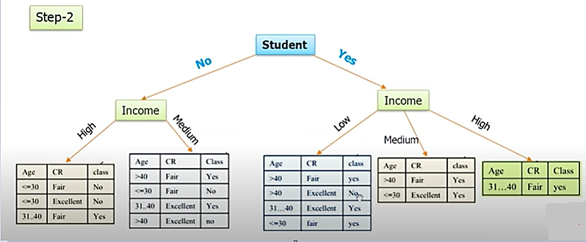

Slide 20
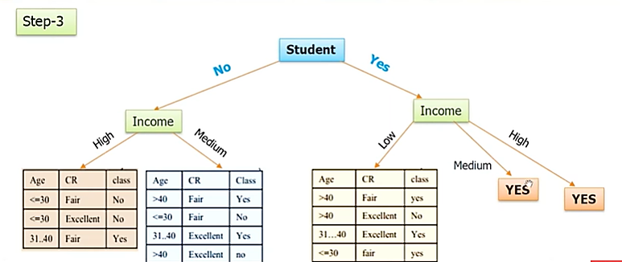

Slide 21
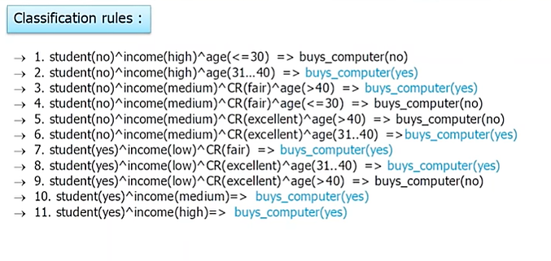

Slide 22
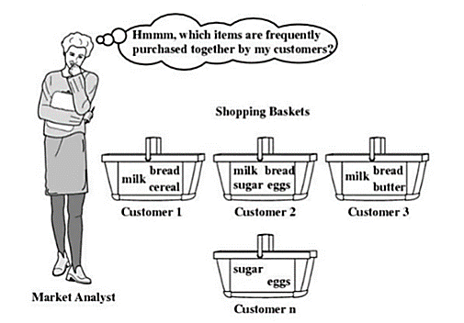
Example 2 – Association Mining Rule

Slide 23
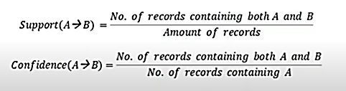
Example 2 – Association Mining Rule
Association Mining Rule is popular and well researched method for discovering interesting relations between variables in large data.
The rule found in the sales data of a supermarket would indicate that if a customer buys Bread and Jam together, he or she is likely to also buy Butter.

Slide 24
Thank You
Contact - +91 9790748175
https://www.linkedin.com/in/m-s-mohan-sivam-281305a7/
https://github.com/msmohansivam/FDP-SEC-Machine-Learning-Techniques

